Slide 1

Autonomous Driving
CHUN SHING LEUNG

Slide 2
AGENDA
Introduction
How Data Science is Used in Autonomous Driving
Example – Road sign recognition
SUMMARY

Slide 3
INTRODUCTION
Autonomous driving refers to the ability of a vehicle to operate without human intervention.
Self-driving cars are equipped with sensors, cameras, and other technologies that allow them to perceive their environment, monitor important systems, and control navigation

Slide 4
autonomous driving levels
Level 0 (No Automation): The driver is responsible for all aspects of driving.
Level 1 (Driver Assistance): The vehicle features a single automated system for driver assistance, such as steering or accelerating (cruise control).
Level 2 (Partial Driving Automation): The vehicle can control both steering and accelerating/decelerating. However, a human sits in the driver’s seat and can take control of the car at any time.
Level 3 (Conditional Driving Automation): Level 3 vehicles have “environmental detection” capabilities and can make informed decisions for themselves, such as accelerating past a slow-moving vehicle. But―they still require human override. The driver must remain alert and ready to take control if the system is unable to execute the task.
Level 4 (High Driving Automation): The vehicle can perform all driving tasks under certain conditions, such as on a highway. However, the driver may still need to take control in certain situations.
Level 5 (Full Driving Automation): The vehicle can perform all driving tasks under all conditions. There is no need for a human driver

Slide 5
Data Science BEHIND AUTONOMOUS DRIVING
The data gathered from sensors, cameras, and other technologies in self-driving cars can be used to improve all the processes related to vehicles and to make driverless cars a reality
Environmental perception: Autonomous cars use sensors to perceive their environment and detect obstacles, pedestrians, and other vehicles. Data science algorithms are used to process this data and make informed decisions for the car.
Path planning: Data science is used to plan the best route for the car to take based on the data collected from sensors and cameras. This includes identifying the optimal speed, lane, and direction.

Slide 6
How Data Science Is used in Facial Recognition
Machine learning: Machine learning algorithms are used to train autonomous cars to recognize patterns and make decisions based on the data they collect. For example, deep learning techniques are used for scene classification, path planning, scene understanding, lane and traffic sign recognition, obstacle and pedestrian detection, and motion control.
Data analysis: Data science is used to analyze the vast amounts of data collected by autonomous cars to identify patterns and improve performance. This includes analyzing data on driving behavior, traffic patterns, and road conditions.

Slide 7
Road sign recognition
Source:
(PDF) Faster R-CNN based Traffic Sign Detection and Classification (researchgate.net)
Traffic sign classification using CNN and detection using faster-RCNN and YOLOV4
Build a CNN that can classify 43 different traffic signs from the German Traffic Sign Recognition benchmark dataset
The dataset is made up of 39,186 images for training and 12,630 for testing. Our CNN for classification is light and reached an accuracy of 99.20% with only 0.8 M parameters

Slide 8
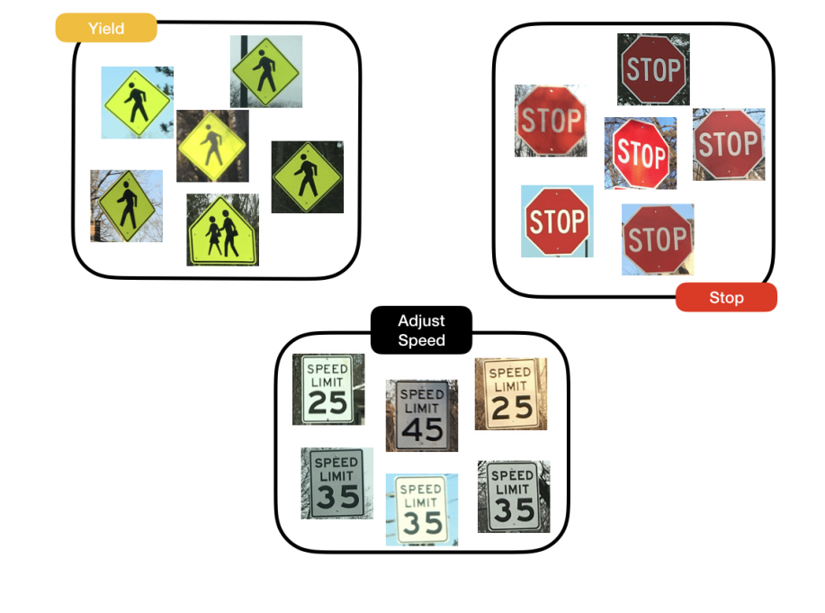
Road sign recognition
k-Nearest Neighbors (kNN)

Slide 9
When a vehicle's camera observes an object, it must classify the object before it can react.
Use machine learning to classify the sign's type.
An algorithm called k-Nearest Neighbors, or kNN, uses the principle of nearest neighbors to classify unlabeled examples.
R's knn function searches a dataset for the historic observation most similar to the newly-observed one.
The knn function is part of the class package, and requires three parameters: first, the set of training data; second, the test data to be classified; and third, the labels for the training data.

Slide 10
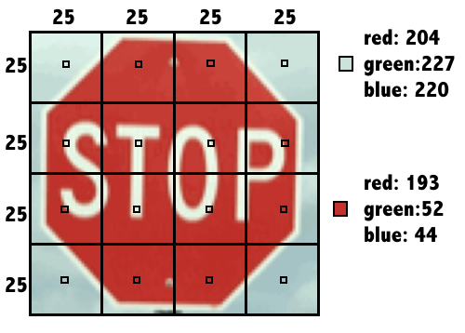
library(class)
Si.gn was divided into a 4x4 grid, and the red, green, and blue level for each of the 16 center pixels is recorded

Slide 11
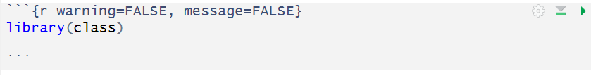
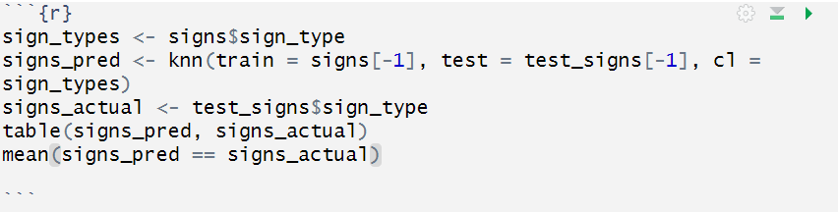
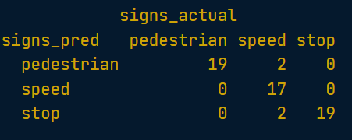
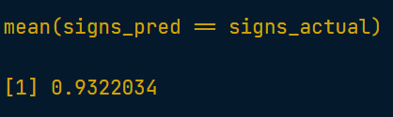

Slide 12
SUMMARY

